Slide 1
Section 504 Program Cynthia Casas Ernesto Salinas

Slide 2
What is Section 504?
Section 504 of the Rehabilitation Act of 1973 is a civil rights law that prohibits recipients of federal funding from discriminating against individuals with disabilities. Under Section 504, children with disabilities must be educated with their non-disabled peers "to the maximum extent appropriate.” Students with disabilities must be given the same opportunities to participate in academic, nonacademic and extracurricular activities as their non-disabled peers. This law applies to public elementary and secondary schools, as well as other education entities.

Slide 3
Who Is Eligible for Section 504?
Section 504's definition of “a student with a disability” is broader than the IDEA’s (Individuals with Disabilities Act) definition and is not limited to specific disability categories.
Section 504 is the “umbrella” civil rights law covering persons who have a “physical or mental impairment that substantially limits one or more major life activity.” Under Section 504, “major life activities” include caring for one's self, performing manual tasks, walking, seeing, hearing, speaking, breathing, reading, writing, calculating math problems, concentrating, interacting with others, learning and working.

Slide 4
Who Is Eligible for Section 504?
Parents typically ask for services under Section 504 when:
their child has a chronic medical condition, such as asthma or diabetes, that is not covered by the IDEA or
their child has a disability covered by IDEA, such as ADHD or a mild learning disability, but who does not require IDEA services to benefit from their education.
Often students protected under Section 504 have “hidden disabilities”, which include low vision, poor hearing, heart disease, or a chronic illness, such as cancer.

Slide 5
Who Can Refer Students for Section 504?
Anyone can refer a child for evaluation under Section 504. However, while anyone can make a referral, such as parents or a doctor, OCR has stated that “the school district must also have reason to believe that the child is in need of services under Section 504 due to a disability”. Therefore, a school district does not have to refer or evaluate a child under Section 504 solely upon parental demand.

Slide 6
Who Decides if a Student is Eligible for Section 504?
According to the federal regulations: “…placement decisions are to be made by a group of persons who are knowledgeable about the child, the meaning of the evaluation data, placement options, least restrictive environment requirements, and comparable facilities” [34 C.F.R. §104.35(c)(3)].
Unlike Special Education, the federal regulations for Section 504 do not require or even mention that parents are to be a part of the decision-making committee.

Slide 7
Support for Section 504 Students
Each child’s needs are determined individually. Determination of what is appropriate for each child is based on the nature of the disabling condition and what that child needs in order to have an equal opportunity to compete when compared to the non-disabled. There is no guarantee of A’s or B’s or even that the student will not fail. Students are still expected to produce. The ultimate goal of education for all students, with or without disabilities, is to give students the knowledge and compensating skills they will need to be able to function in life after graduation.

Slide 8
Services Available for 504 Students
Under Section 504, students with disabilities may receive accommodations as well as supplementary aids and services to ensure that their individual educational needs are met as adequately as those of non-disabled students.

Slide 9
Services Available for 504 Students
Types of Accommodations:
Presentation: A change in the way information is presented.
Response: A change in the way a child completes assignments or tests.
Setting: A change in the environment where a child learns.
Timing and scheduling: A change to the time a child has for a task.

Slide 10
Services Available for 504 Students
Accommodations under Section 504 include many different things such as:
Physical changes to the school that are necessary for your child to be able to use the school building, such as installing a wheelchair ramp, handrails, or motorized doors.
Changes in rules, policies, or procedures to let your child have the same chances to participate in school activities as their peers without disabilities. An example is letting a child with diabetes have a snack in the classroom or letting a child with ADHD stand up when needed during class.
Learning aids, like time with a literacy specialist, using a calculator on a math test, or typing an essay instead of writing it out by hand.
Changing gym class requirements for a child with asthma or another physical disability.

Slide 11
Services Available for 504 Students
Examples of testing (both classroom and standardized tests) accommodations are:
Different test formats, such as test printed in Braille or a large print test booklet and answer sheet.
Having someone read test questions aloud to a student who has trouble reading.
Letting students who cannot write say their answers aloud to a person who writes them down.
Increasing the amount of time a student is given to complete the test or assignment – or giving them extra breaks.

Slide 12
Services Available for 504 Students (Remote Learning)

Slide 13
Teacher Responsibilities for Section 504 During Remote Learning
Requirement from Mrs. Sarabia, Section 504 District Coordinator:
All teachers providing instruction to 504 students in their classrooms will be responsible for turning in a parent contact log at the end of the Six Weeks.
The parent log will be turned in to me and I will turn it in to Mrs. Sarabia.
Example:

Slide 14
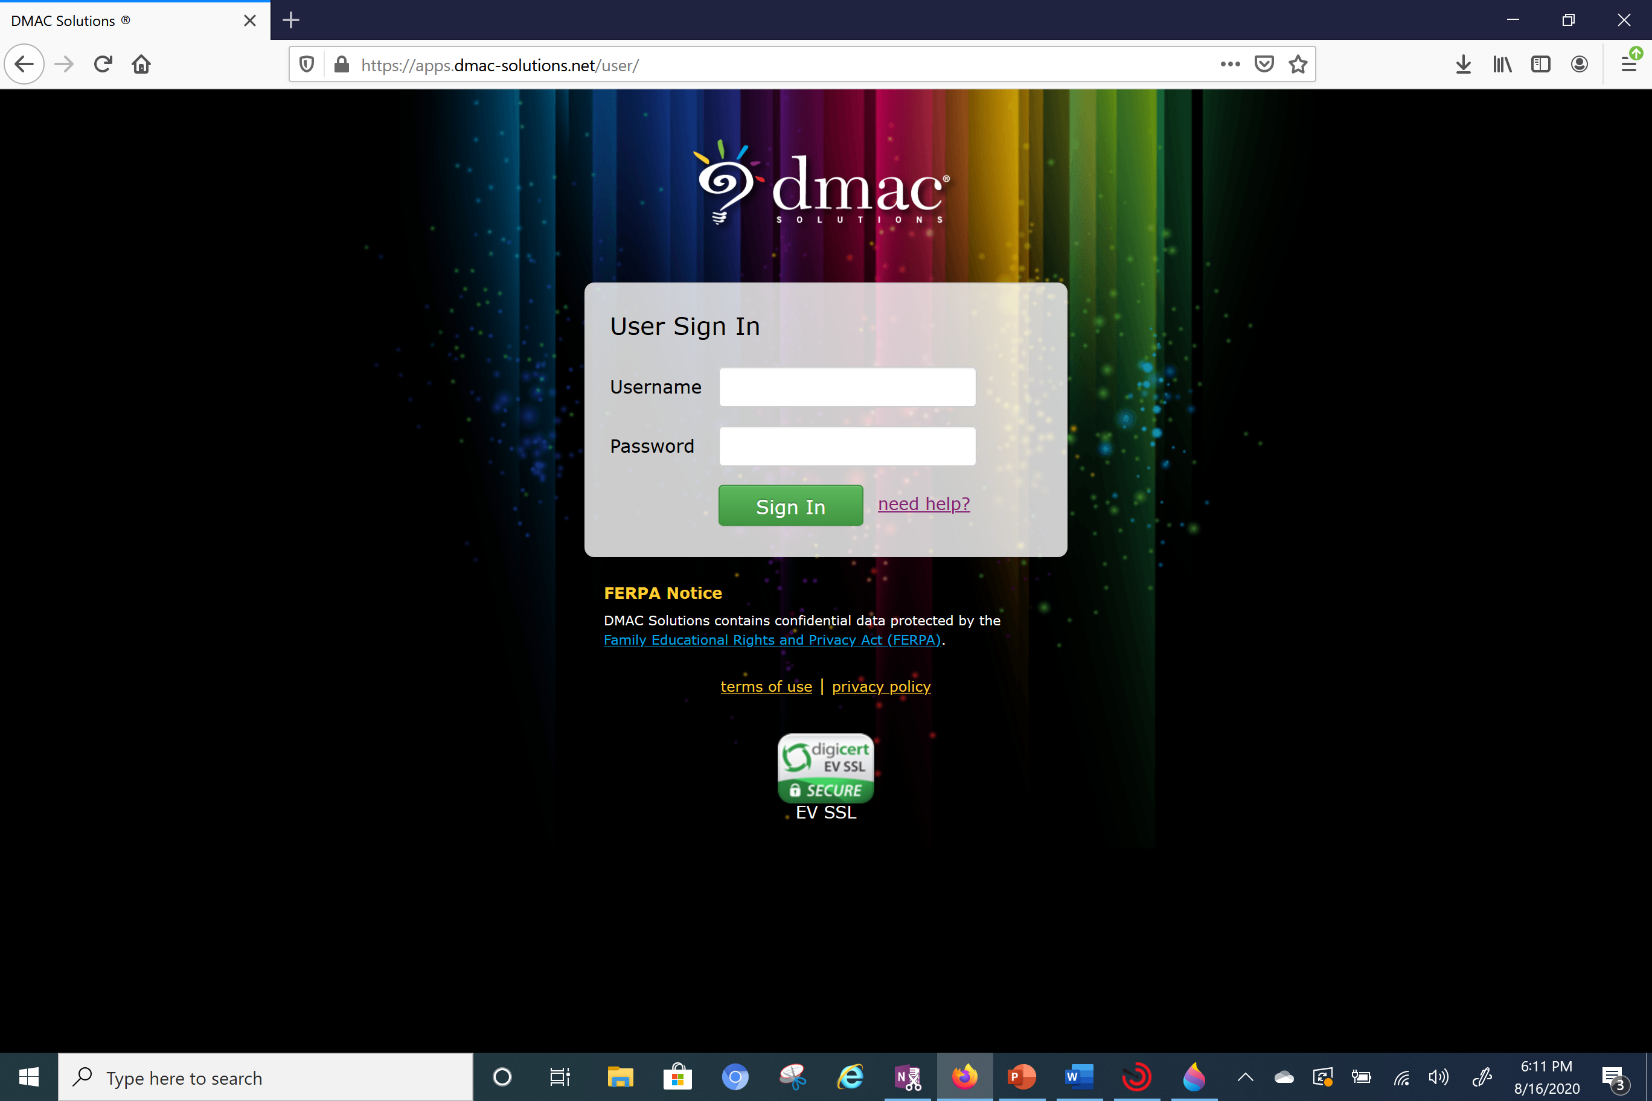
To View Student 504 Plans
Log on to DMAC Solutions

Slide 15
To View Student 504 Plans
Click on Student Portfolio

Slide 16
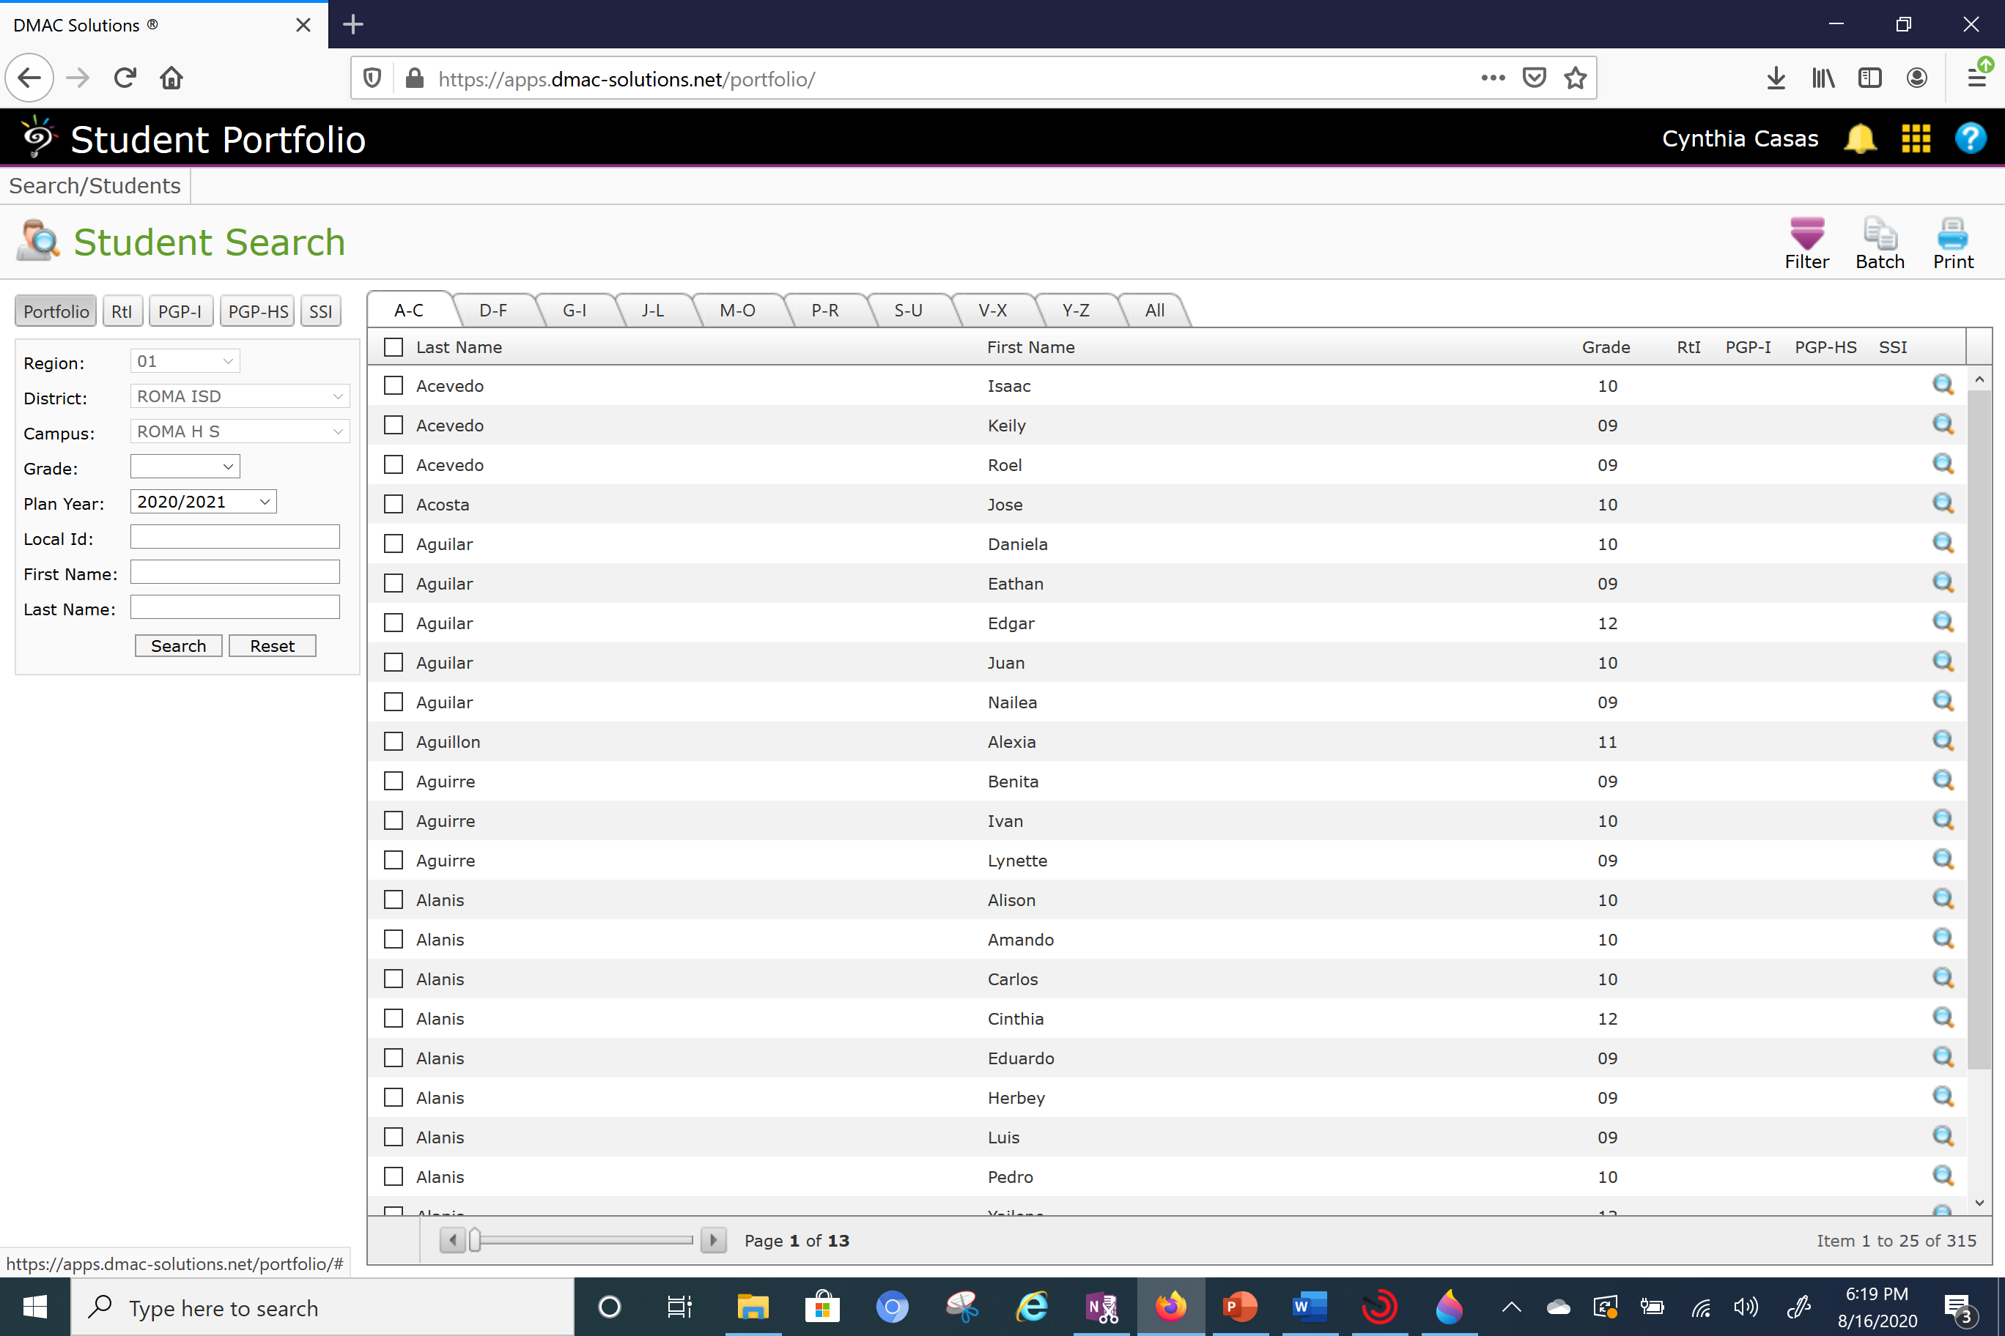
To View Student 504 Plans
You will type in Student ID or Student Name and then click on Search.
You will then click on the magnifying glass to view record.

Slide 17
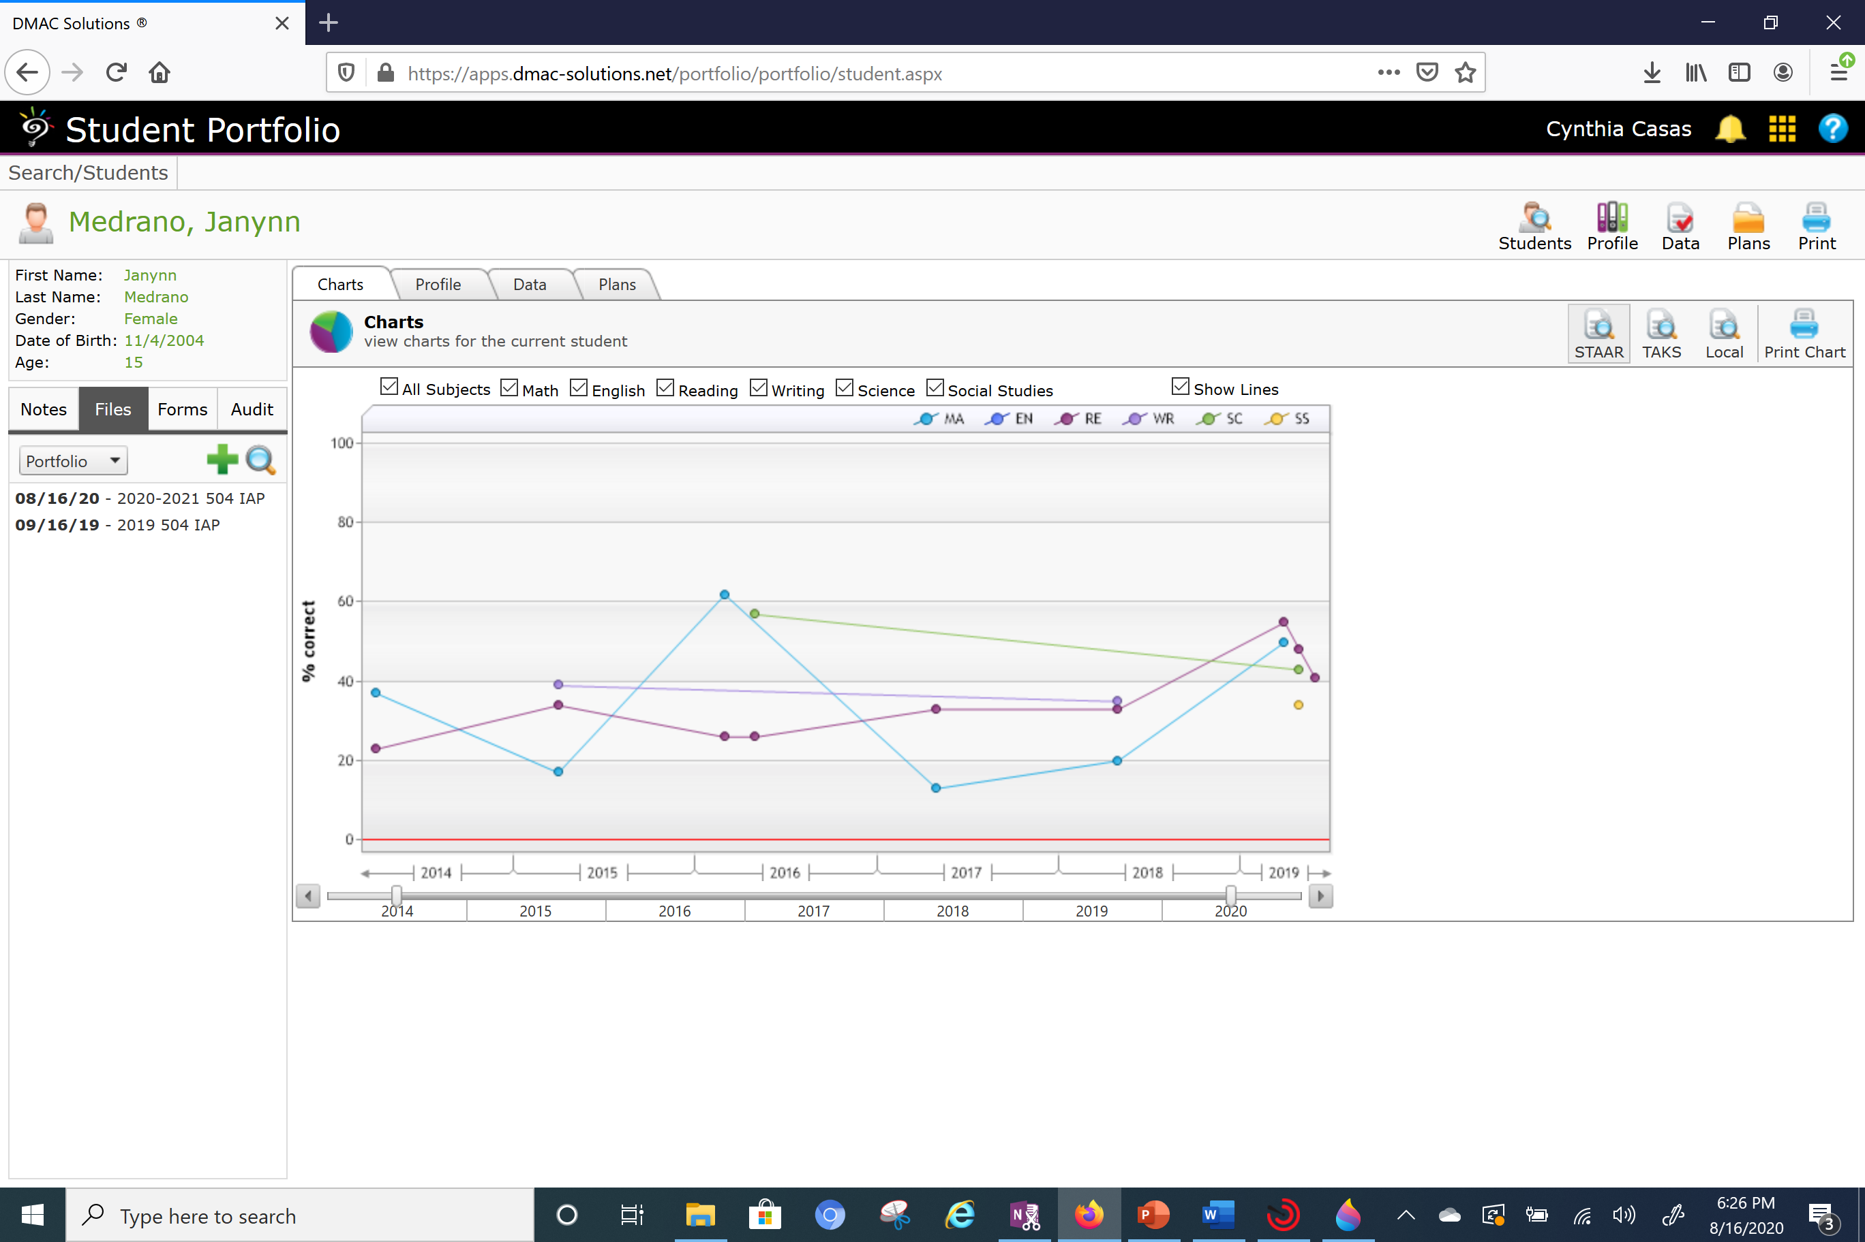
To View Student 504 Plans
On this screen you will click on Files
You will then click on the magnifying glass to view record.

Slide 18
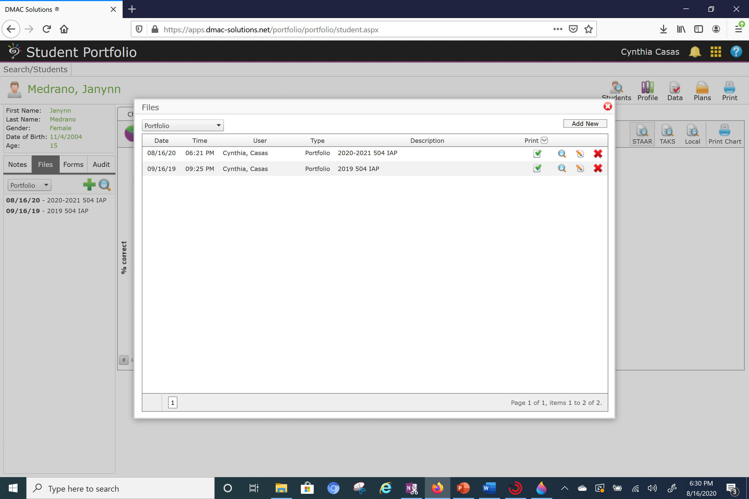
To View Student 504 Plans
On this screen you will click on the magnifying glass to view record. Make sure it is the correct school year.

Slide 19
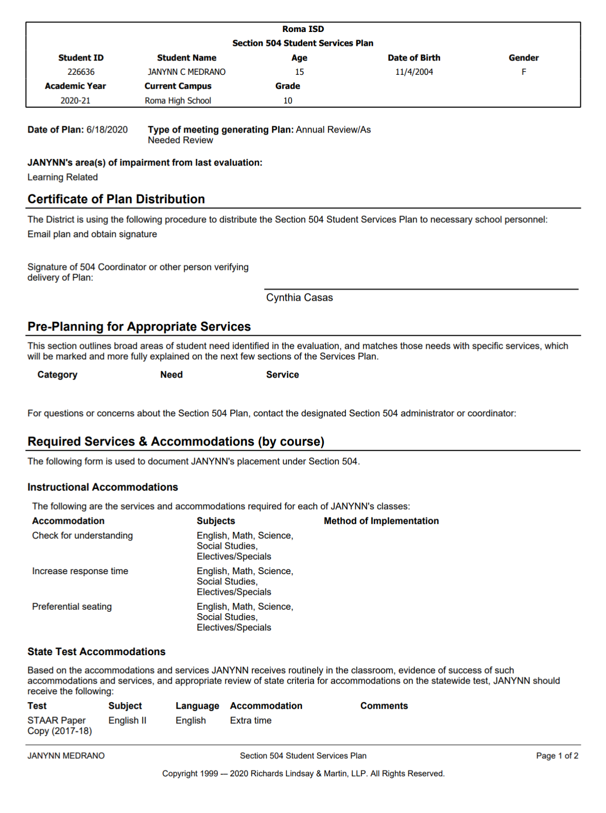
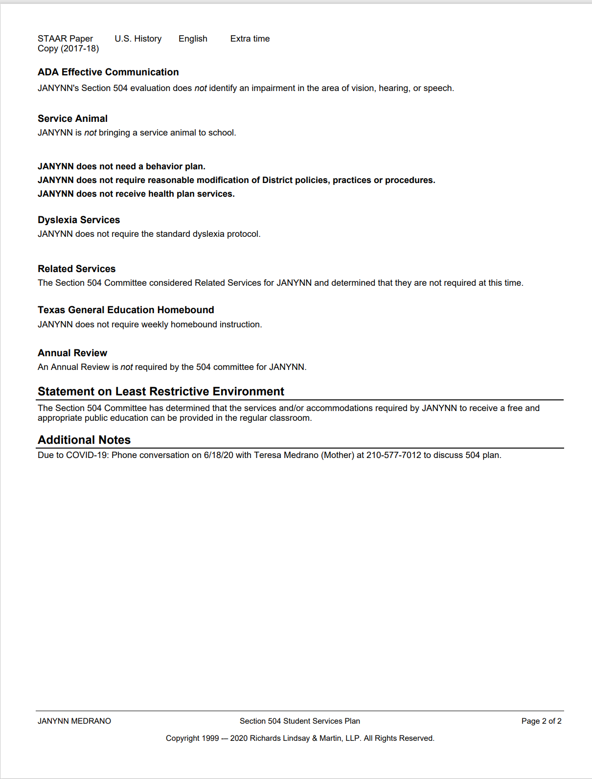

Slide 20
Questions/Concerns
Cynthia Casas – 504 Coordinator
ccasas@romaisd.com
Office – A5

